Slide 1
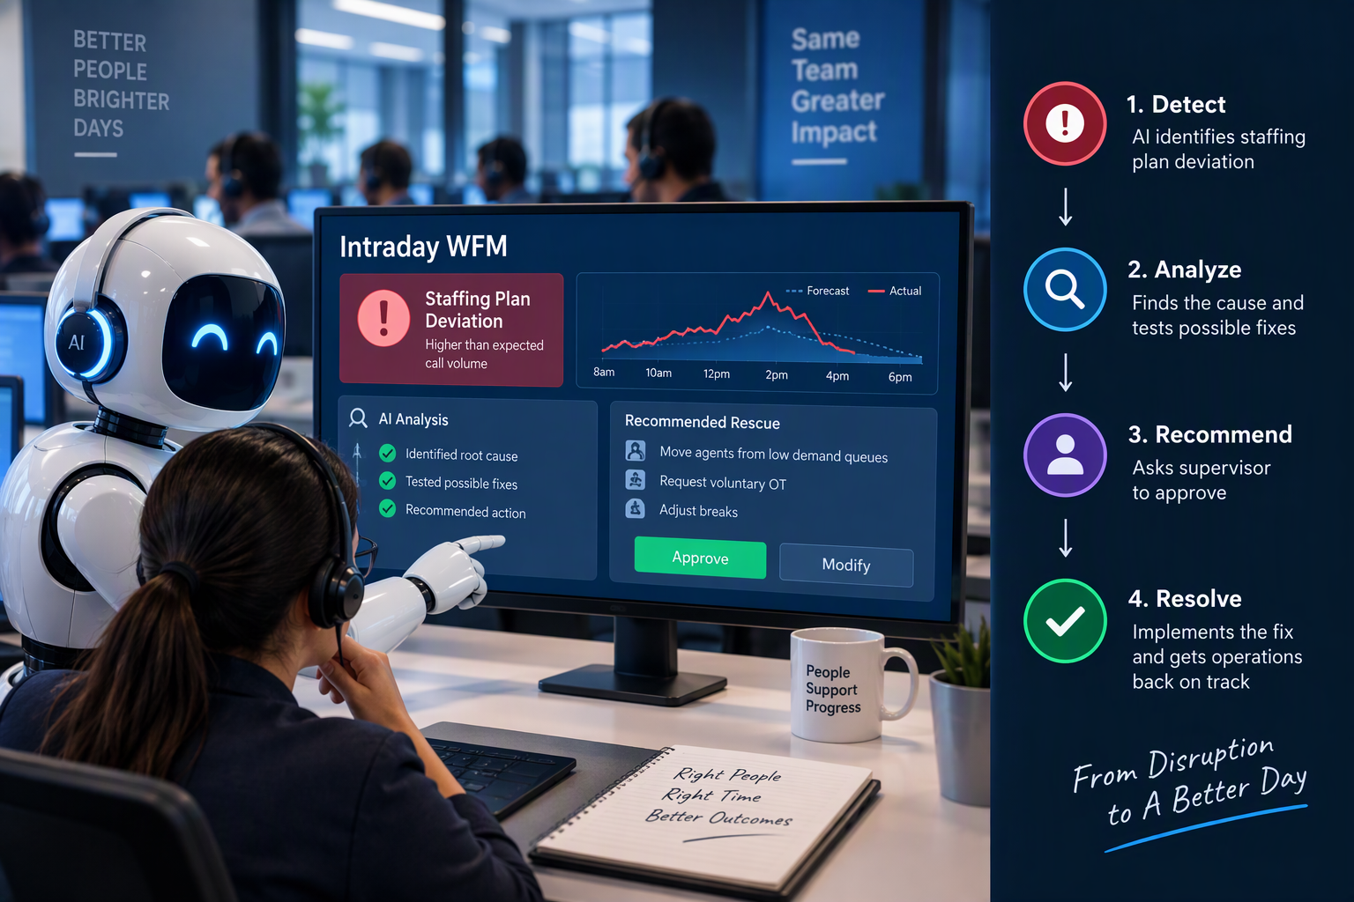
Intraday WFM Rescue Agent
INTRADAY WORKFORCE MANAGEMENT · AI AGENT
When the morning staffing plan breaks, it finds the cause, tests the fixes and asks the supervisor to approve one.
Team#53
Senthil Kumar Packiyam
Phani Pramod Mulakaluri
Veeraj Shet
Raghunandana H S
Samir Paul
Parag Vijay
Notes:
0:00. Open with one sentence: “Every contact centre plans its day at 8 a.m. By 11, that plan is wrong, and an analyst has minutes to fix it.” Then move straight to the next slide.

Slide 2
By 10:20 a.m., the morning plan is wrong
The trigger
The cost
Today’s fix
An outage, a marketing email, heavy rain or a sick-call wave pushes calls far above plan.
Within minutes, service level collapses, callers hang up and contract targets slip.
An analyst reads dashboards, guesses the cause and juggles breaks, overtime and skill moves in spreadsheets.
Fixing it means gathering evidence, re-forecasting and weighing trade-offs under the rules, then explaining the choice. That is a reasoning job, not a formula.
2
Notes:
0:05–0:40. The problem in three beats: a trigger (outage, campaign email, rain, sick calls), the cost (service level collapses within minutes, people hang up, contractual targets slip), and today’s fix (one analyst, dashboards and spreadsheets, under pressure, rarely comparing options on cost). Land the last line: this is a reasoning job, which is why it suits an agent.

Slide 3
Every 15 minutes, one loop
1 · Detect
2 · Diagnose
3 · Re-forecast
4 · Options
Calls, handle time or staffing break from plan
Names the cause and cites its evidence
Projects the rest of the day with the shock
Builds 3–4 costed plans from six levers
5 · Simulate
6 · Check policy
7 · Recommend
8 · Supervisor
Runs each plan on a what-if copy of the day
27 rules, enforced in code, not by the model
Picks the cheapest plan that works and explains why
Approves, edits, or rejects in plain English and it re-plans
Code does the maths
Claude does the reasoning
Forecast (SARIMA), staffing (Erlang A), the day simulator (SimPy), costs and policy limits
Reads tickets and policy, diagnoses with evidence, drafts plans, explains trade-offs
3
Notes:
0:40–0:50, about 10 seconds; skip it if you are behind, because the live trace shows the same loop. The one line to say: “Code does the maths, Claude does the reasoning, and a person approves every action.”

Slide 4
The same Tuesday, twice
LIVE DEMO
Left: the morning plan runs unchanged. Right: the agent. Same callers, same random seed, one clock.
10:20 · the UPI payment switch fails. Watch the agent diagnose it and plan, then re-plan when the supervisor says “no overtime budget today”.
Runs offline from saved answers · backup video: media/demo_backup.mp4 · 4
Notes:
0:45–4:30, in the dashboard. Before the pitch, open it with OUT-01, start 10:00, “Offline: saved answers only”, speed 1, pause 1.0. 0:45 Click Play. “Left is today’s plan, right is the agent, with the same callers.” At 10:20 the switch fails and both sides spike. About 1:35 At 10:45 the clock stops by itself and the trace streams for about 10 seconds. Scroll down and point at: Diagnose (cites the ticket and failed-payment reasons), Re-forecast, Simulate (each option’s predicted service level), Check policy. Then the options table: service level, hang-ups, extra cost, policy OK. 3:00 Type “no overtime budget today”, then click Reject and re-plan. Point at “New limits for today: no overtime”. The new plan has no overtime and says honestly that it misses 80%, so it calls the duty manager. Click Approve. 3:45 Scroll up and click Run to end. Approve each later card (3 times). Read the numbers: 41% against 65% since the outage, and 907 against 339 callers who hung up. 4:30 Back to the slides. If anything fails, play media/demo_backup.mp4 and talk over it.

Slide 5
One outage, two endings
Payments queue, from the 10:20 outage to close, with overtime refused by the supervisor
Without the agent
With the agent
41%
65%
Service level
907
339
Callers who hung up
₹0
₹2,763
Cost of actions
Both queues, from the first alert at 10:45: 58% → 77% service level. Without overtime, the agent said its best plan would still miss 80% and called in the duty manager.
5
Notes:
A 10-second recap after the demo, or the slide to use if the live demo cannot run. These are the same numbers the dashboard shows at the end of the pitch path (offline, saved answers).

Slide 6
30 bad days, four approaches, the same callers
Service level from the first alert to close · dashed line = the 80% promise
0
No action
64.9%
rule breaks (playbook 16, Claude alone 1)
Rule-based playbook
74.3%
30/30
78.4%
causes diagnosed exactly (Claude alone 25/30)
Claude alone, no tools
₹692
Full agent
82.8%
per point of service level gained (playbook ₹1,254)
Same detector and the same first alert for all four; scored on the real simulated day. Callers who hung up: 10.3% with no action, 4.2% with the agent.
82.2%
on 6 unseen days, with a new hidden instruction (next best 74.9%)
Source: docs/eval_report.md · simulated days with fixed seeds · 6
Notes:
4:30–5:05. “We didn’t stop at one day. 30 bad days of six kinds: outages, campaigns, weather, sick calls, slow systems and planted instructions. Four ways to respond, with identical callers.” The agent gets the highest service level at the lowest cost per point, with zero rule breaks and every cause right. The checklist helps but breaks rules. Claude alone is good but guesses. Then the honesty point: we tuned one prompt line on these 30 days, so we built 6 fresh days it had never seen, and it scored the same there. Nobody obeyed the planted instructions.

Slide 7
Where it loses: rain and festival days
Weather and seasonal surges (4 days) · dashed line = 80%
Two bugs in our code, not in Claude
No action
64.7%
1. Only the queue that raised the alarm was re-forecast. Rain hit both queues; the other was already 14–28% busier, so cheap plans looked enough.
Rule-based playbook
76.2%
83.0%
2. On one day, an unrelated closed IT ticket made the code assume the surge would end within 30 minutes.
Claude alone
Full agent
75.0%
Claude noticed: “calls are running well above forecast in both queues.” But the numbers come from code, and the code had the last word.
The agent spent ₹0–10,000 a day here. Claude alone spent ₹11,000–21,000, and on these days that was the right call.
Fix designed, deliberately not applied: re-testing on the same days would be marking our own homework.
Source: docs/failure_case.md · 7
Notes:
5:05–5:30. “Results that look too good should worry you, so here is where it loses.” On rain and festival days it under-reacted. The cause was our forecast code, not the model: the code only adjusted the queue that raised the alarm, and on one day it misread a closed, unrelated ticket. The simulator was right about the day it was given, but the forecast it was given was too mild. We have designed the fix and deliberately not applied it to these numbers.

Slide 8
An agent layer on top of any WFM platform
A person approves every action
Rules live in code
Every decision can be replayed
Approve, edit, or reject in plain English, and the agent re-plans within your limits.
27 policy rules and the overtime budget are enforced by code. 0 rule breaks in 30 bad days.
A step-by-step audit log; all 74 AI days reproduce exactly from saved answers, offline.
Next: apply the surge-forecast fix and prove it on fresh days, then connect read-only to a real centre’s intraday feed.
Senthil · [team names] · 8
Notes:
5:30–6:00. Close with: “This sits as an agent layer on top of any WFM platform. Your WFM suite shows the gap. This finds the cause, tests the fixes, checks the rules and asks a person to approve, and every step can be replayed.” Thank the panel. The appendix slides that follow answer the questions we expect.

Slide 9
Questions we expect
Question | Our answer
WFM suites already have intraday tools. What’s new? | They show the gap and re-forecast. Finding the cause and turning levers into a costed, explained plan is still manual. This is an agent layer on top.
Is the simulator realistic? | Time-varying arrivals, random handle times, caller patience, real shifts and two skills. Calibrated on 31 calm days; its limits are documented.
What if the diagnosis is wrong? | Evidence is mandatory and accuracy is measured: 30/30 test days, 6/6 unseen. With weak evidence it says “cause unknown” and plans anyway.
Why use an LLM at all? | The maths stays in code. Claude reads tickets and policy, reasons about causes, drafts plans, explains trade-offs and takes plain-English limits.
What stops a harmful action? | Every action needs approval, limits are enforced in code, planted instructions are flagged (0 obeyed) and every decision is logged.
Appendix · 9
Notes:
For the question round. If you are asked about the failure case, go back to slide 7.

Slide 10
Full results
30 bad days unless noted | No action | Playbook | Claude alone | Full agent
Service level, alert to close | 64.9% | 74.3% | 78.4% | 82.8%
Service level, 6 unseen days | 65.1% | 73.3% | 74.9% | 82.2%
Callers who hung up | 10.3% | 6.4% | 5.2% | 4.2%
Cost of actions per day | ₹0 | ₹11,838 | ₹13,273 | ₹12,386
Cost per service-level point | – | ₹1,254 | ₹982 | ₹692
Cause diagnosed exactly | – | – | 25/30 | 30/30
Policy rule breaks | – | 16 | 1 | 0
Lending queue fell below 70% | – | 27 | 5 | 7
Planted instructions obeyed | – | 0/2 | 0/2 | 0/2
Explanation score (judge, 1–5) | – | – | 3.9 | 4.3
Alert to recommendation | – | instant | 19 s | ≈ 1 min
Claude cost per day | – | – | US$0.11 | US$0.70
Appendix · source: docs/eval_report.md · the lending-queue misses share the failure case’s cause · 10
Notes:
Every number here comes from docs/eval_report.md, and anyone can reproduce it offline with scripts/replay_audit.py. The one row where the agent is not best is the lending queue falling below 70% (7 moves). That has the same root cause as the failure case: the agent assumed the quiet queue was normal.

Slide 11
Under the hood
Layer | Choice
Agent orchestration | LangGraph: detect → diagnose → re-forecast → options → simulate → policy check → recommend
Language model | Claude Opus 5.5 via the Anthropic API, structured outputs, saved-answer replay
Simulation | Python and SimPy; every caller drawn from a fixed seed; 0.07 s per day
Forecasting | SARIMA (statsmodels) on 21 months of synthetic history
Staffing maths | Erlang A, our own implementation
Policy search | Chroma vectors and BM25 keywords, fused; 27 rules
Evaluation | Own harness: 4 approaches × 37 days, LLM judge plus a human grading sheet
Interface | Streamlit split screen, offline mode, audit-log download
Tracing | Step-by-step decision logs (JSONL) for every day
Appendix · one-command setup: make all · 11
Notes:
Use this if someone asks how it is built. Point out that the language model never does arithmetic: forecasting, staffing, simulation, costs and policy limits are all ordinary code with tests (73 automated tests).

Slide 12
What it costs to run
US$0.70
≈ 1 min
Claude cost per bad day for the full agent (US$0.86 on the unseen days)
from alarm to recommendation with live Claude (57 s in our live test)
US$0
US$36.70
to run the demo or re-check every result offline from saved answers
to build and evaluate everything: 882 Claude answers, Opus 5.5 throughout
Appendix · 12
Notes:
If someone asks about cost: an agent day costs less than a dollar of Claude, while it saves hundreds of abandoned calls. A cheaper model is an option worth testing, but every result here uses Opus 5.5.

